Slide 1


NYU Summer Machine Learning Program
Presenter Name Here
Date Here

Slide 2
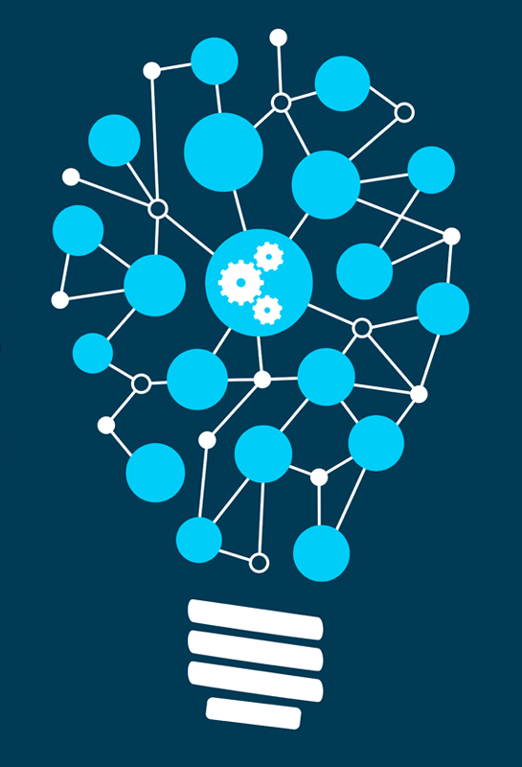
Convolutional Neural Network
Day 7

Slide 3
Acknowledgement
Some slides in this presentation is from Professor Sundeep Rangan’s Machine Learning course

Slide 4
Outline
Motivation
1-D Convolution
Up/Down Sampling
Images in Computers
2-D Convolution
Pooling
Deep Network Architecture

Slide 5
Recent History of Deep Neural Networks

Slide 6
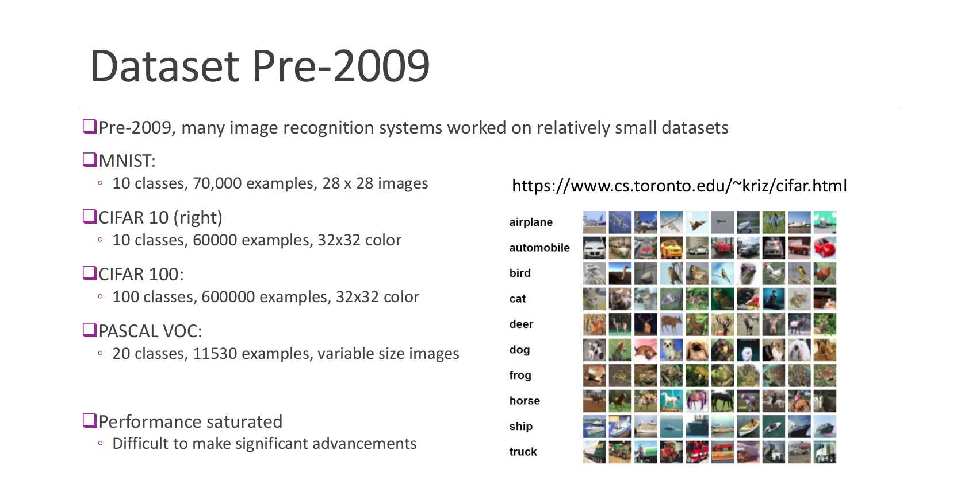

Slide 7
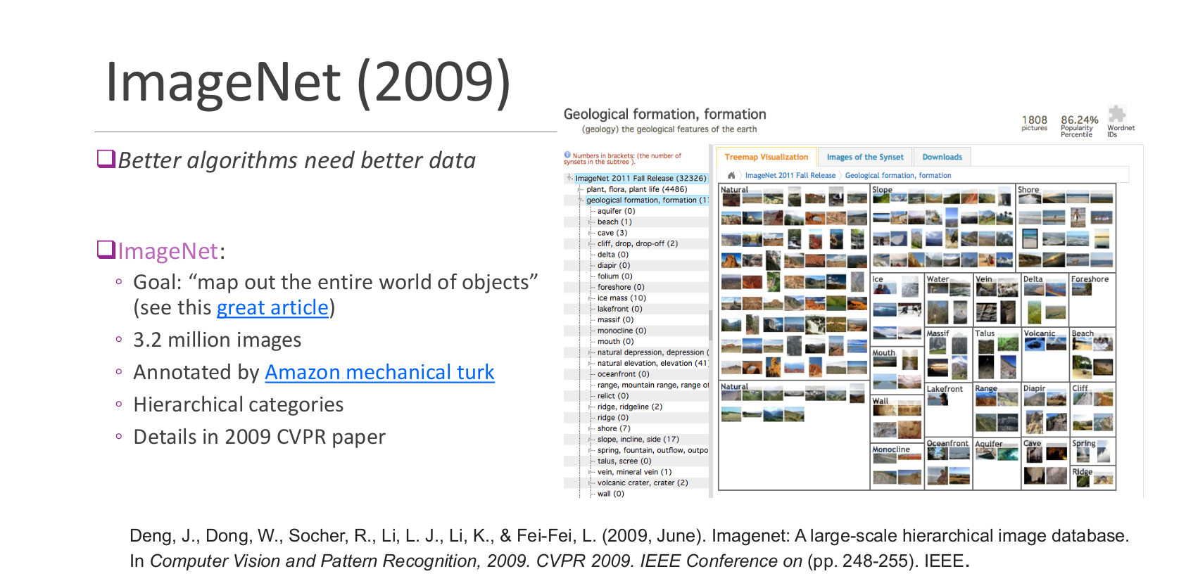

Slide 8
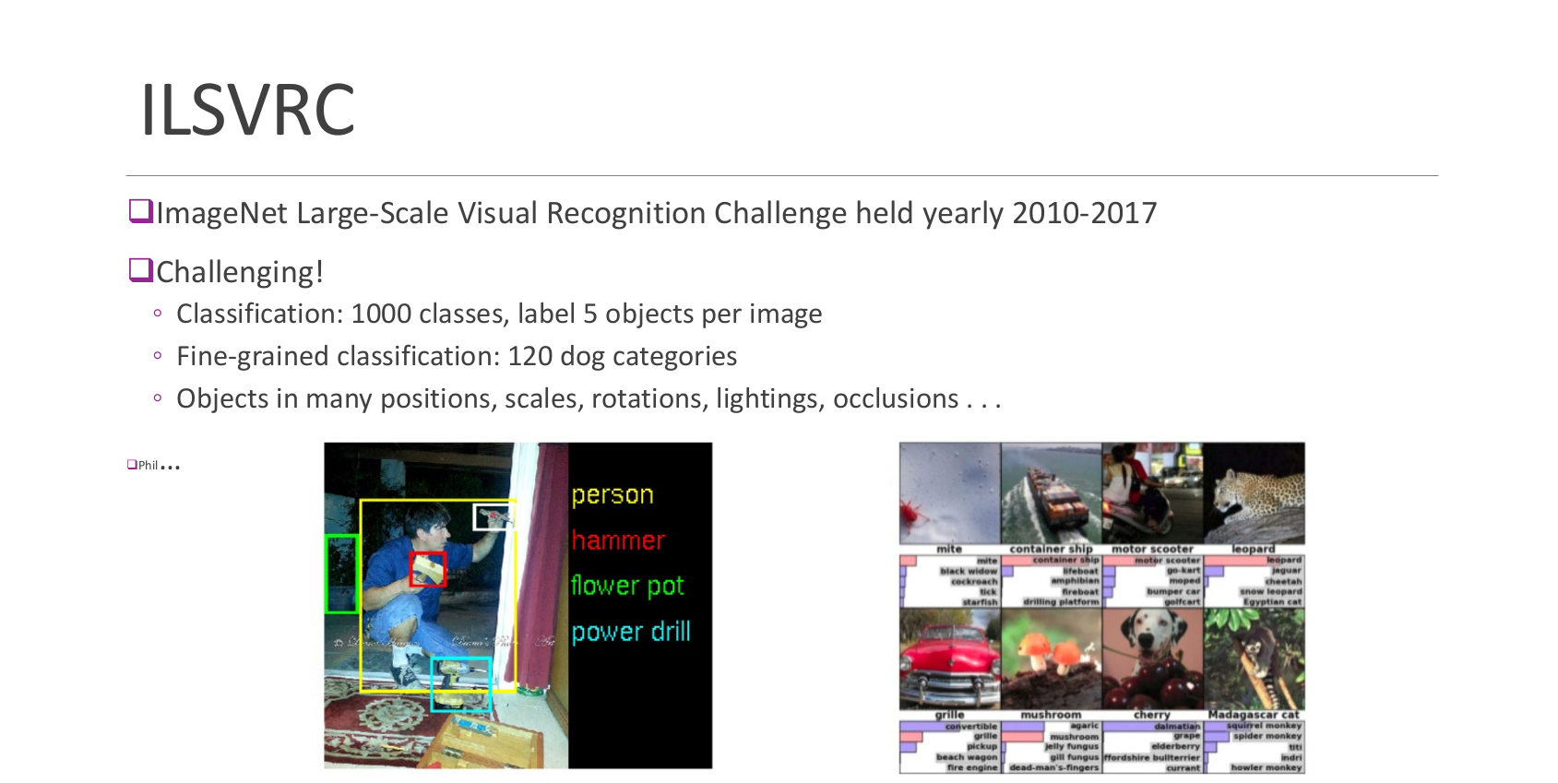

Slide 9
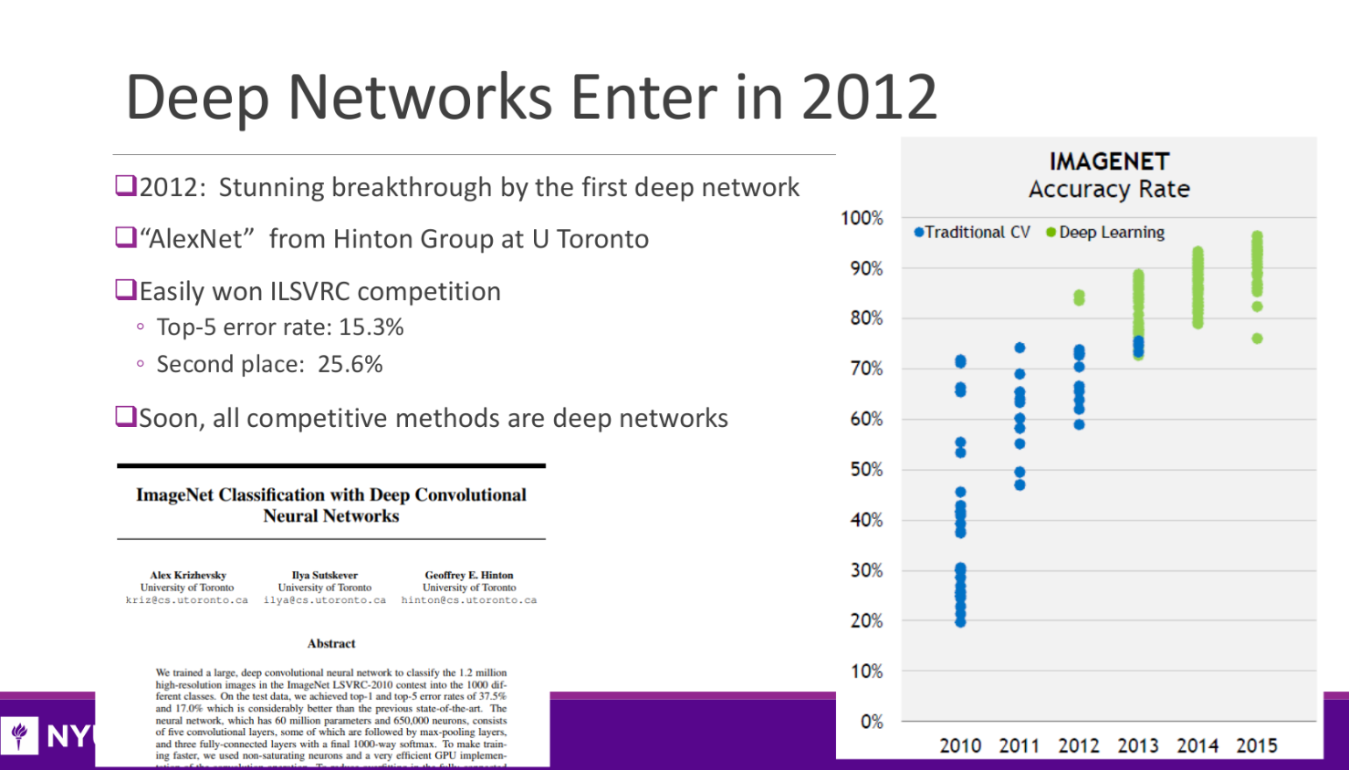

Slide 10
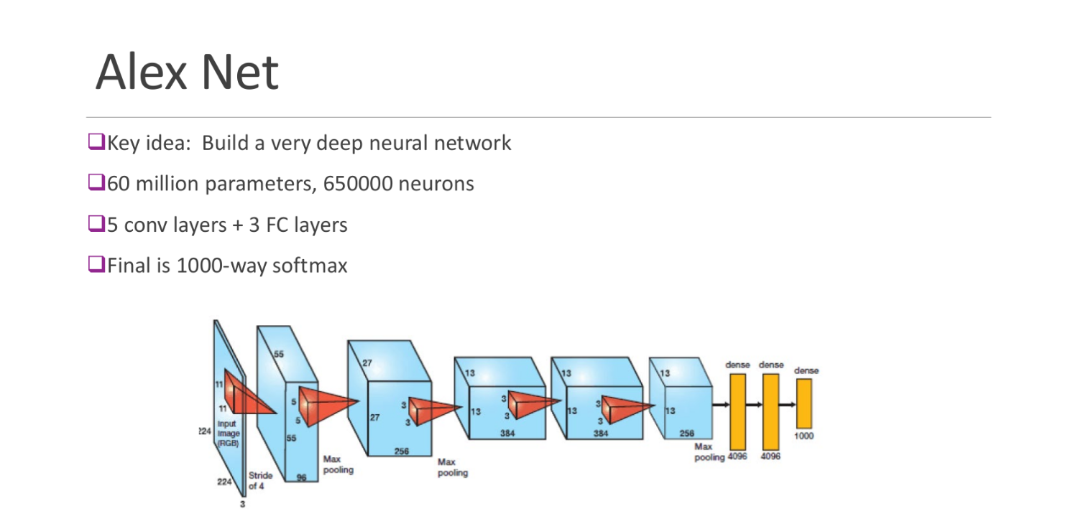

Slide 11
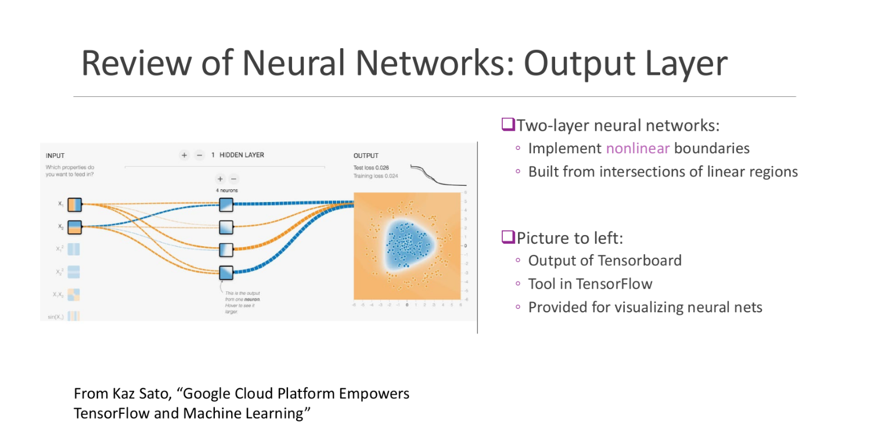

Slide 12
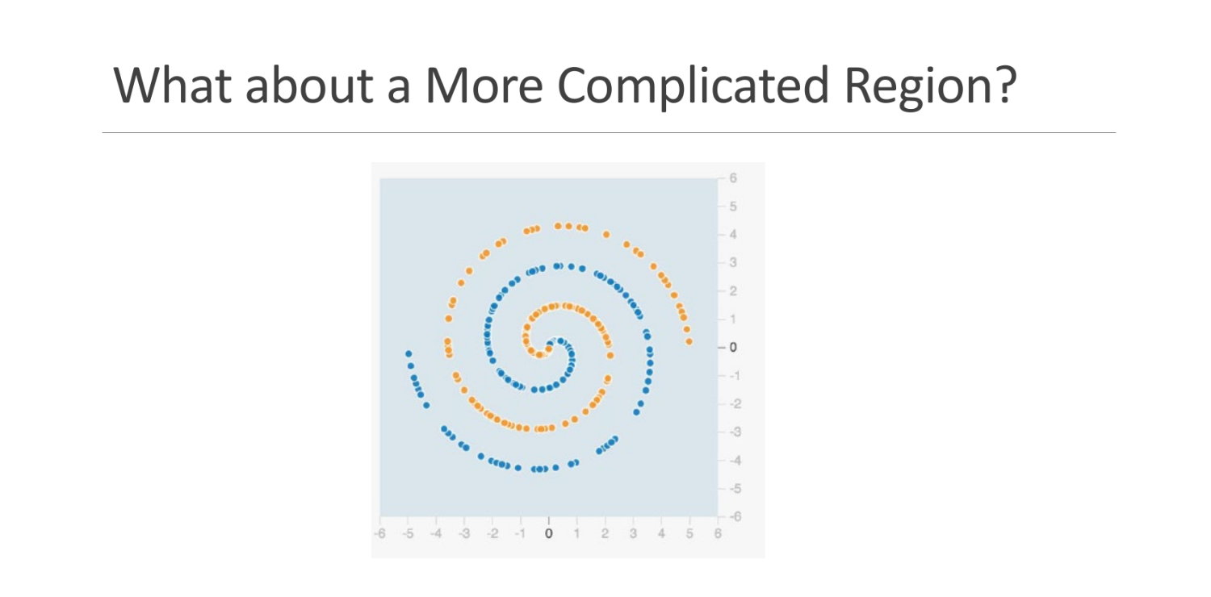

Slide 13
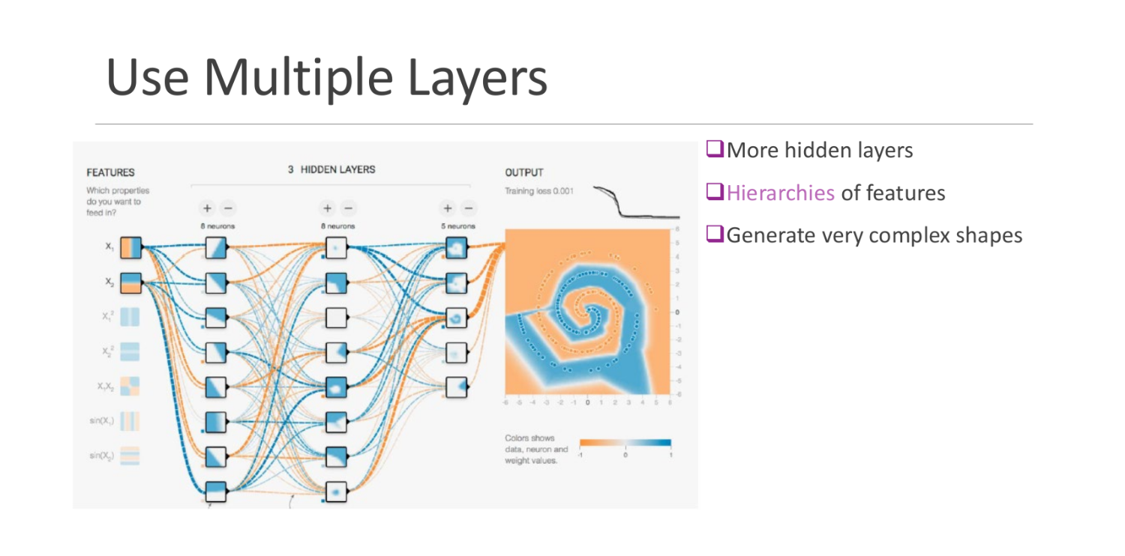

Slide 14
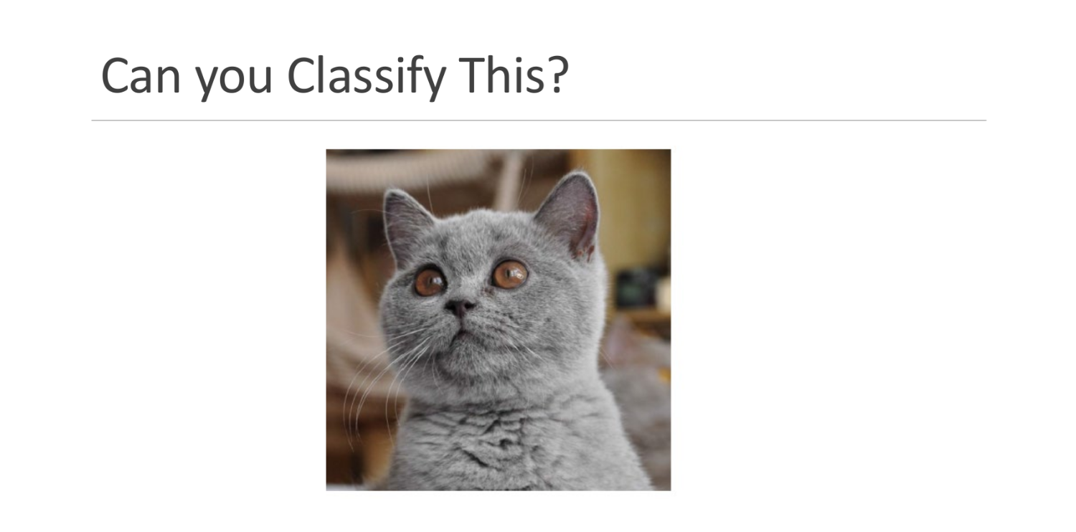

Slide 15
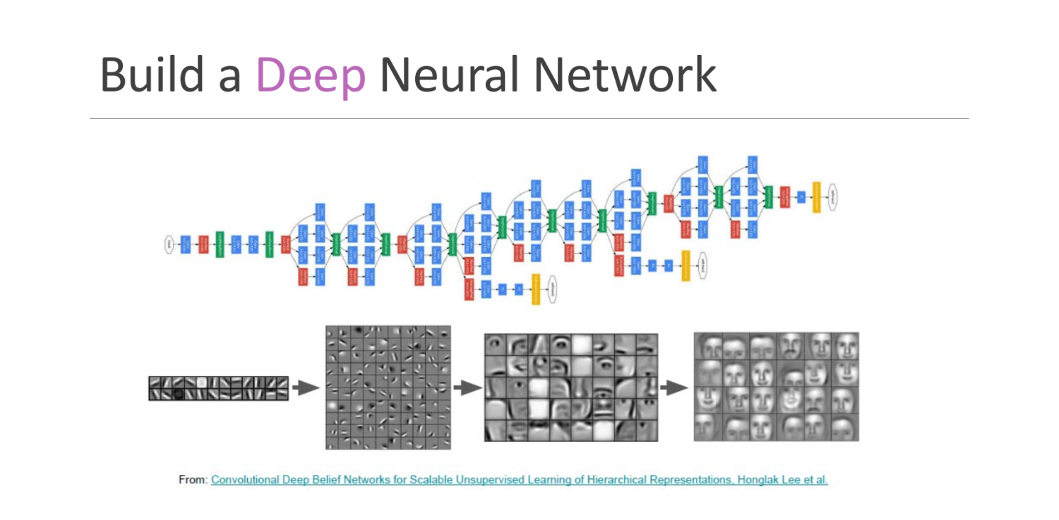

Slide 16
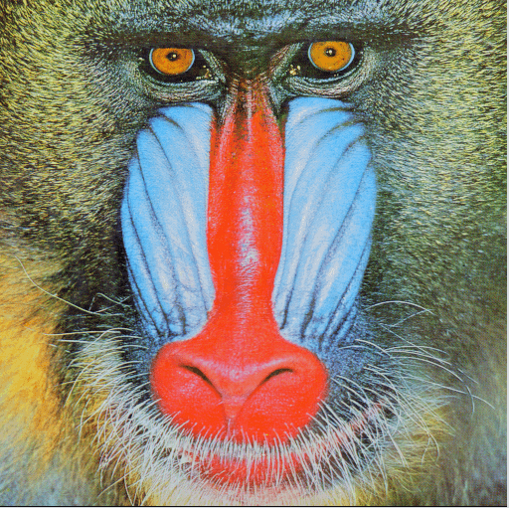
CNN Motivation: Locality & Feature Extraction
Things closer together tend to be more related (red)
Feature extraction: A face has eyes, mouth, nose
Fully connected NN layer considers all areas equally related (green)
Must we consider whiskers and eyes together?
Maybe we can learn locality? Can we “bake it in” to the NN?

Slide 17
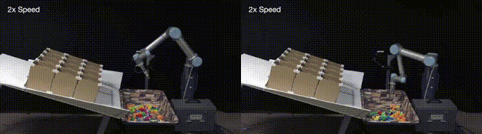
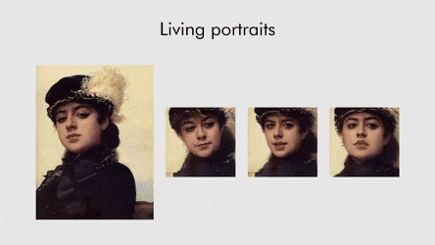

CNN Motivation: Locality & Feature Extraction
Ted Talk: the wonderful and terrifying implications of computers that can learn
https://ai.googleblog.com/
Robots Learning to Toss
Few Shot Learning of Realisitic Neural Talking Head Models
Optical Character Recognition and Translation

Slide 18
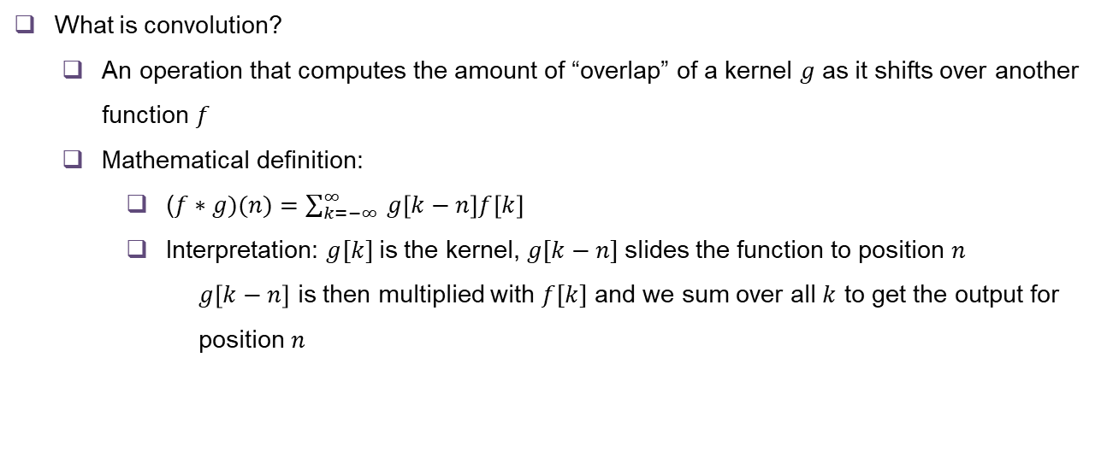
Introduction to Convolution (1-Dimensional)
What is convolution?
An operation that computes the amount of “overlap” of a kernel $g$ as it shifts over another function $f$
Mathematical definition:
($f∗g)(n)=\sum_{k=−∞ }^{∞}{g\left[k−n\right]f\left[k\right]}$
Interpretation: $g[k]$is the kernel, $g[k−n]$slides the function to position $n$
$g\left[k−n\right]$ is then multiplied with $f[k]$ and we sum over all $k$ to get the output for position $n$

Slide 19
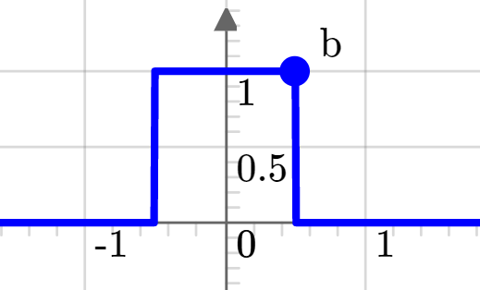
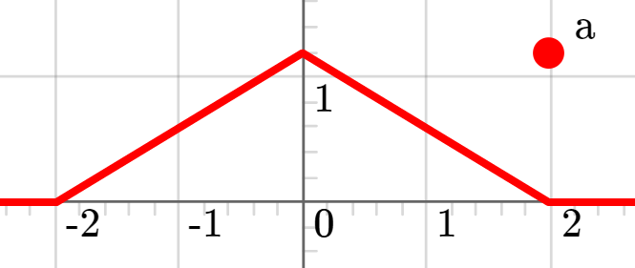
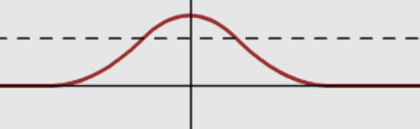
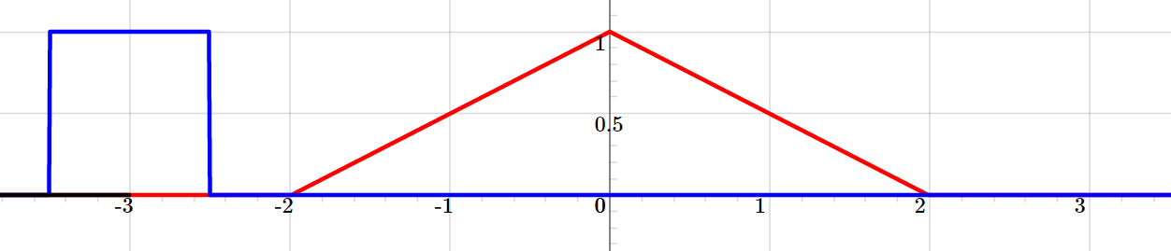
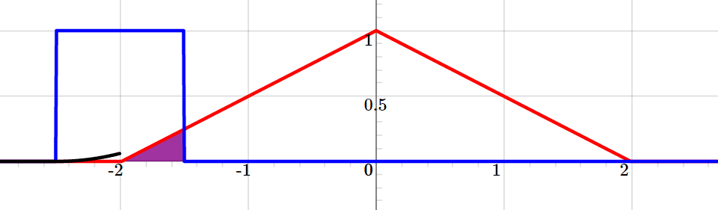
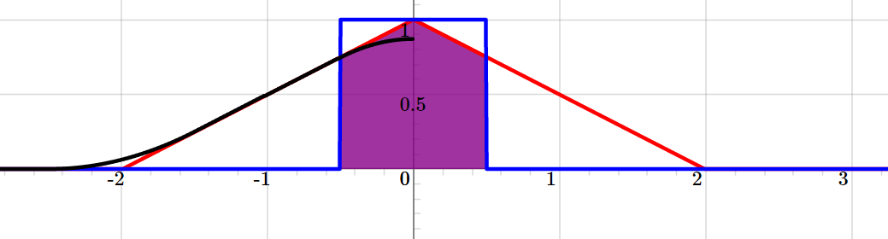
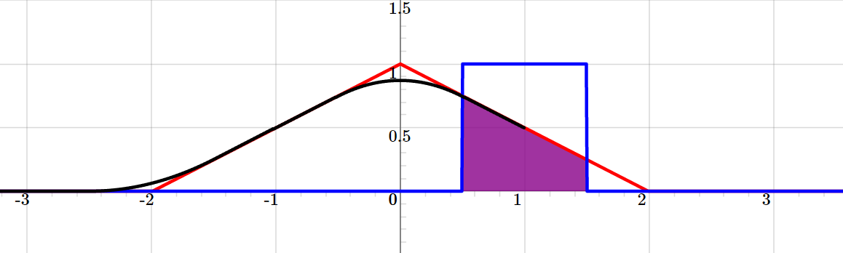
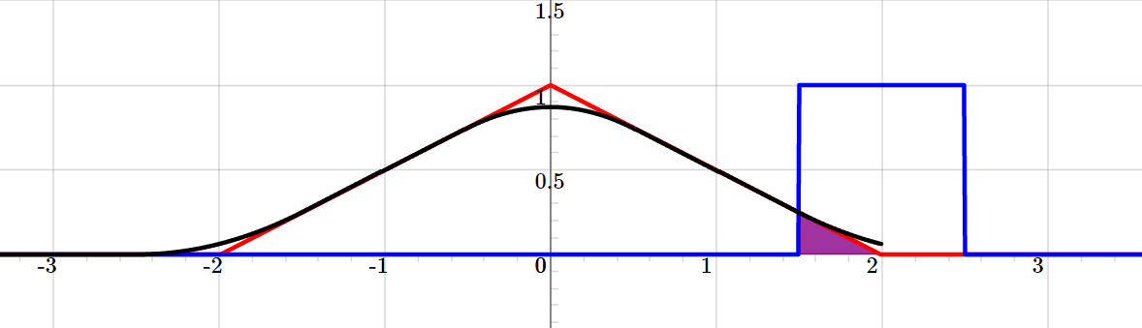
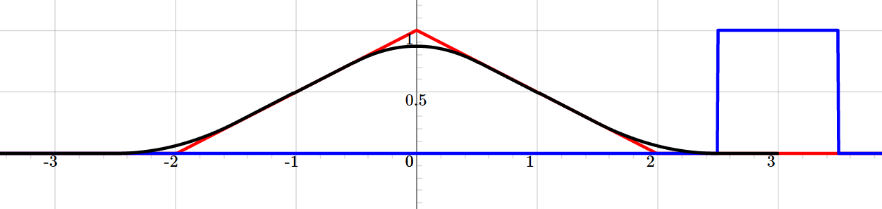
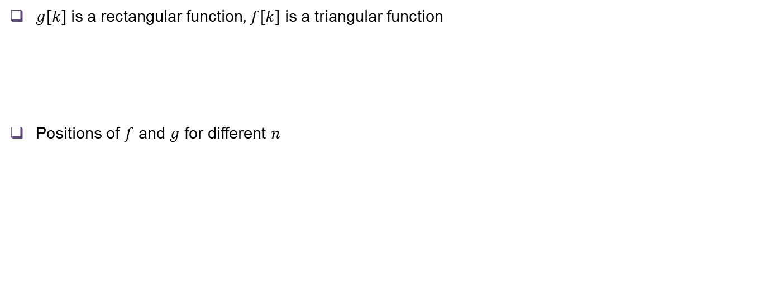
Convolution Illustrated
$g[k]$ is a rectangular function, $f[k]$ is a triangular function
Positions of $f$ and $g$ for different $n$
Output
n = -3
n = -2
n = -0
n = 1
n = 2
n = 3
Demo: https://phiresky.github.io/convolution-demo/

Slide 20
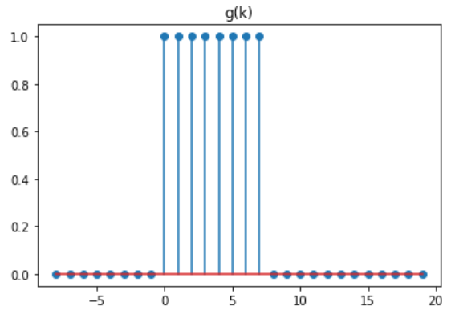
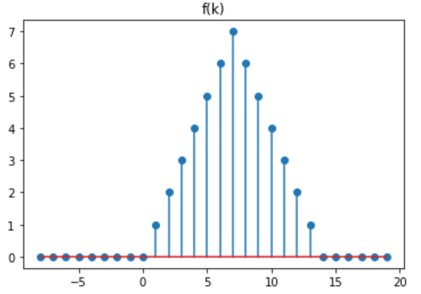
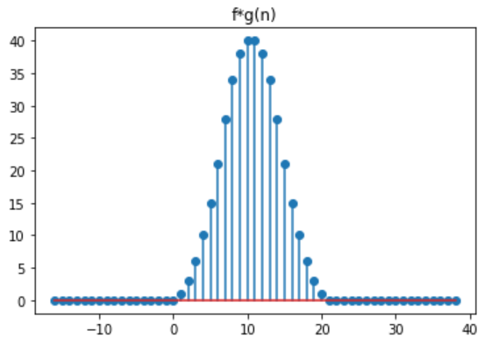
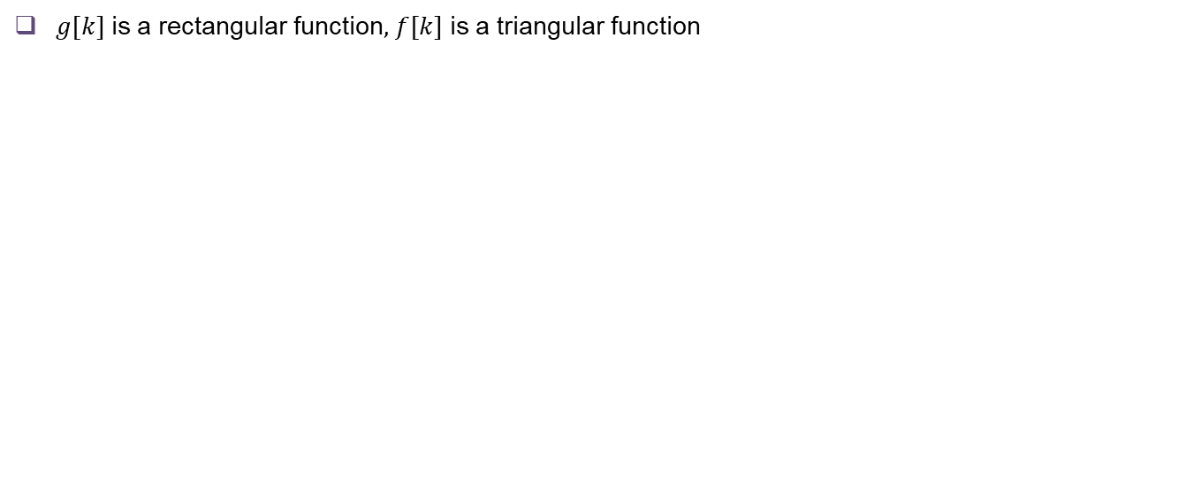
Convolution in Discrete Time
$g[k]$ is a rectangular function, $f[k]$ is a triangular function
Can you tell what does convolution with the rectangular function do to the triangular signal?

Slide 21
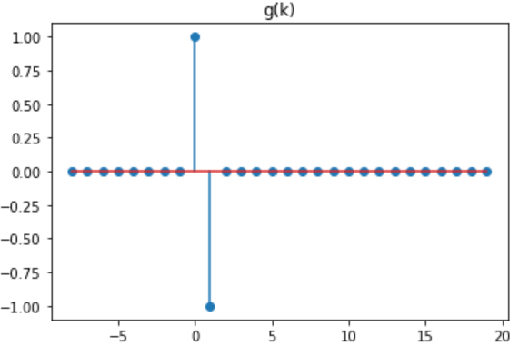
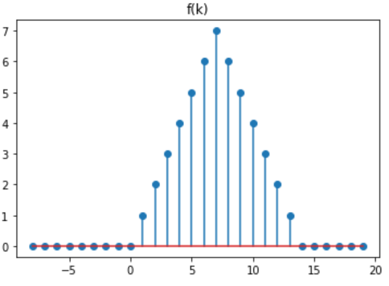
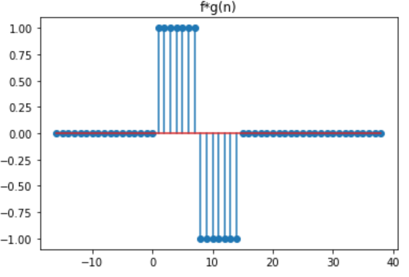
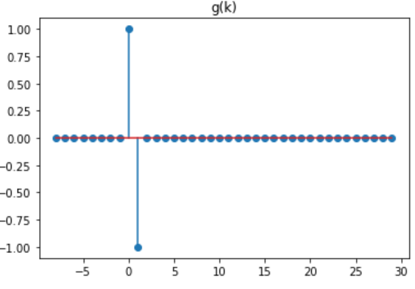
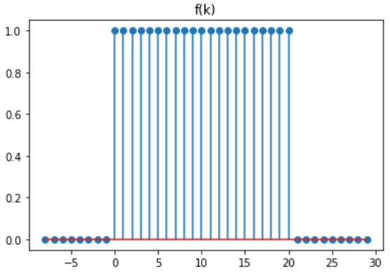
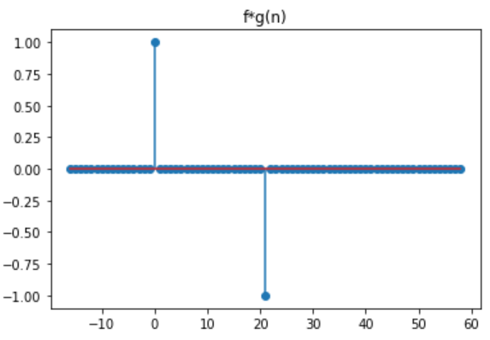
Convolution in Discrete Time
Can you tell what is the affect of this filter?

Slide 22
Why Convolution?
Convolution gives an output that is a weighted sum of several neighboring positions in the input, allowing us to learn local relation
Only a small number of weights need to be learned, as oppose to learning one weight for each position of a long series
This will be useful for processing data like images or audio, where there is a huge number of data points
Different kernels will have different effects on the input: for example, smoothing, sharpening, edge detection, feature detection

Slide 23
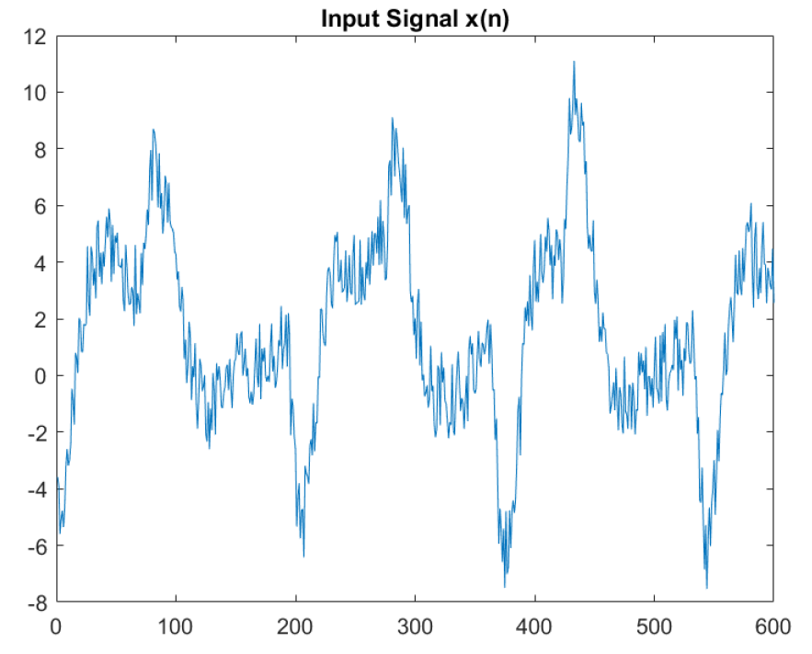
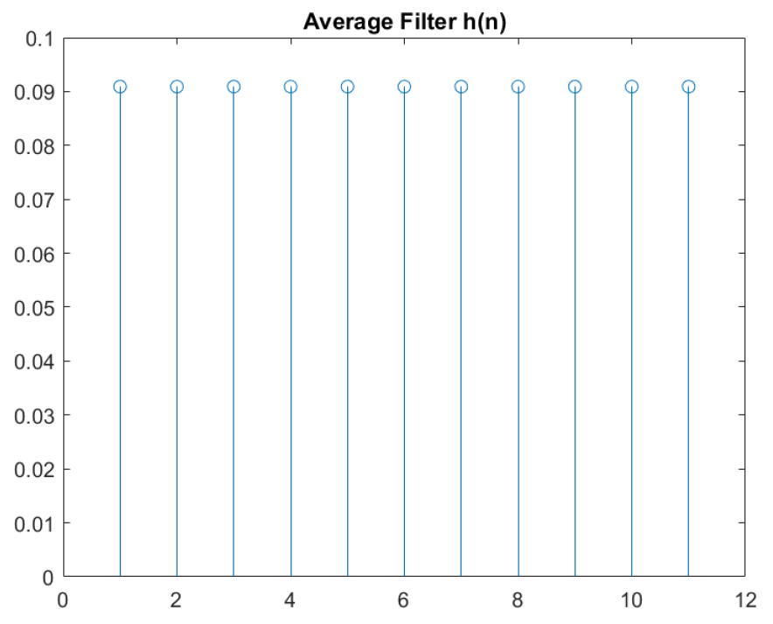
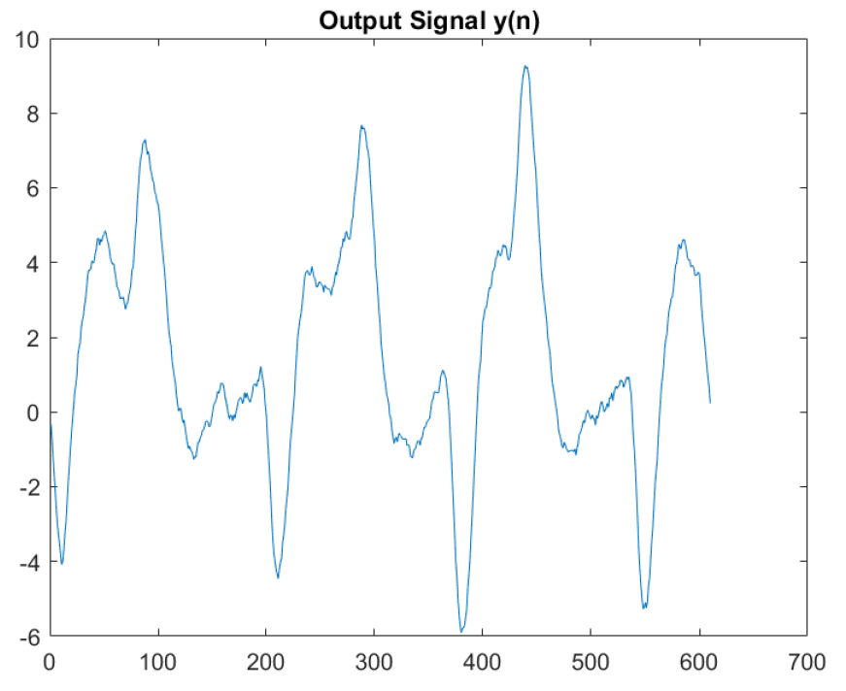
Example: Convolution of a Noisy ECG signal
Convolution with a simple averaging filter smooths the signal and removes the noise

Slide 24
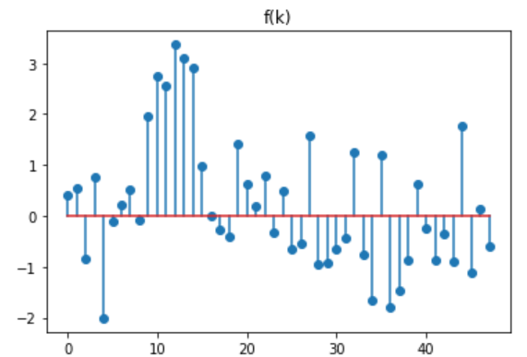
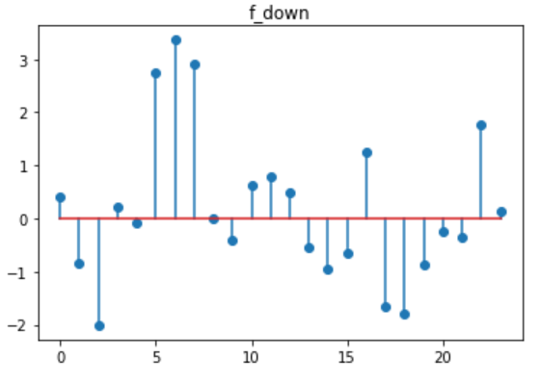
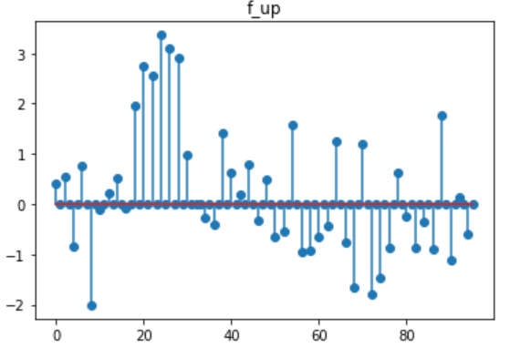
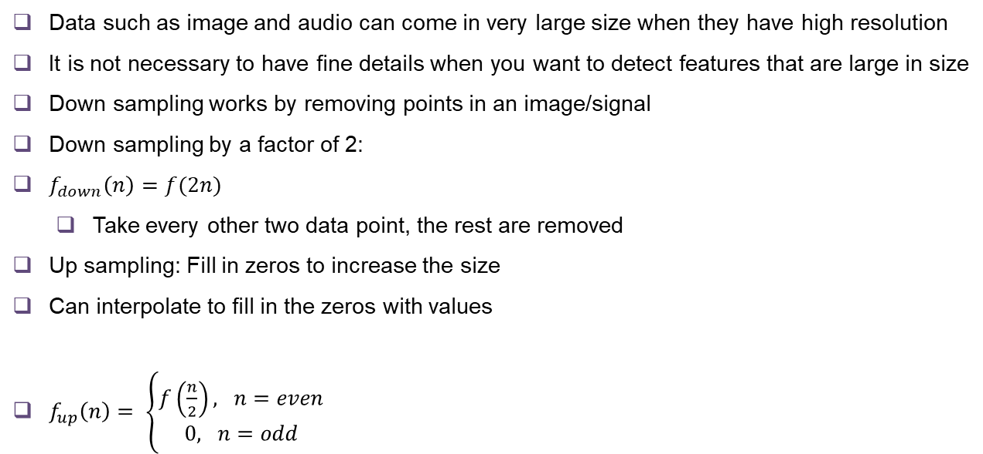
Down sampling and Up sampling
Data such as image and audio can come in very large size when they have high resolution
It is not necessary to have fine details when you want to detect features that are large in size
Down sampling works by removing points in an image/signal
Down sampling by a factor of 2:
$f_{down}\left(n\right)=f(2n)$
Take every other two data point, the rest are removed
Up sampling: Fill in zeros to increase the size
Can interpolate to fill in the zeros with values
$f_{up}\left(n\right)= \left\{\begin{aligned}f\left(\frac{n}{2}\right), n=even \\ 0, n=odd\end{aligned}\right.$

Slide 25
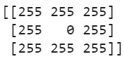
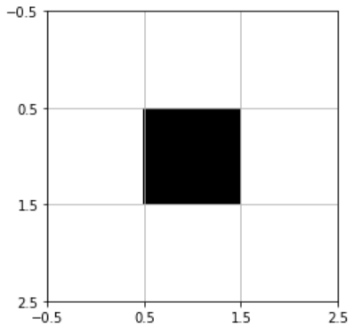
Images in Computer
Images are stored as arrays of quantized numbers in computers
Gray scale image: 2D matrices with each entry specifying the intensity (brightness) of a pixel
Pixel values range from 0 to 255, 0 being the darkest, 255 being the brightest
Color image: 3D array, 2 dimensions for space, 1 dimension for color
Can be thought of as three 2D matrices stacked together into a cube, each 2D matrix specify the R,G,B value at each pixel

Slide 26
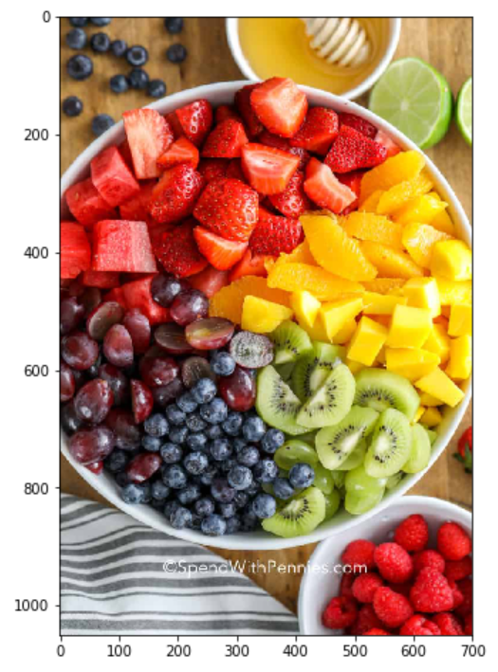
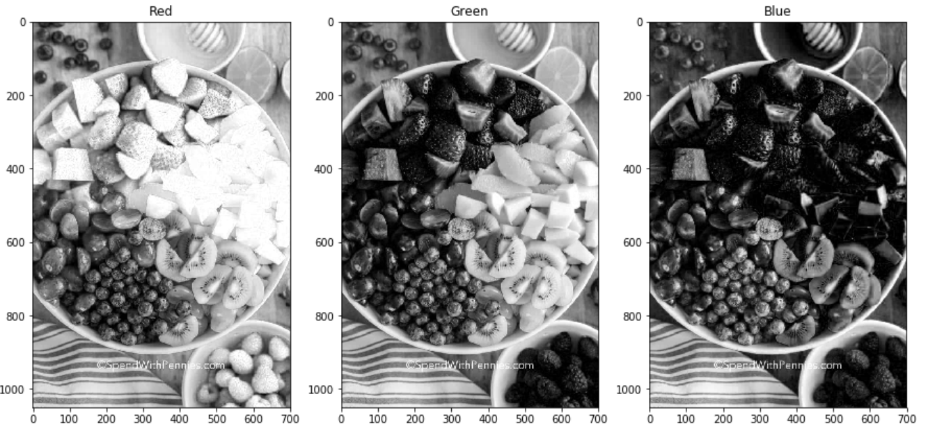
Color Images
Shape of the image array: (1050,700,3)
-> There are 1050x700 pixels, 3 channels: R,G,B

Slide 27
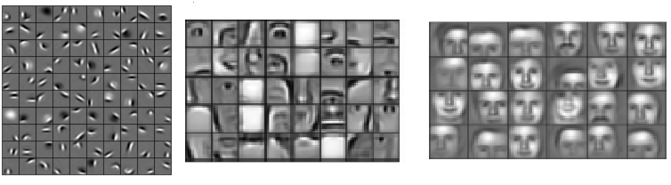
2D Convolutions: Local Features
As we observed from the 1D examples, the purpose of performing convolution is to extract/highlight useful features/information from the input.
The initial layers in a Deep Neural Network are often used to detect local features
These layers detect small patterns in larger images examples: small lines, curves, edges
The subsequent layers combine local features to create more complex features

Slide 28
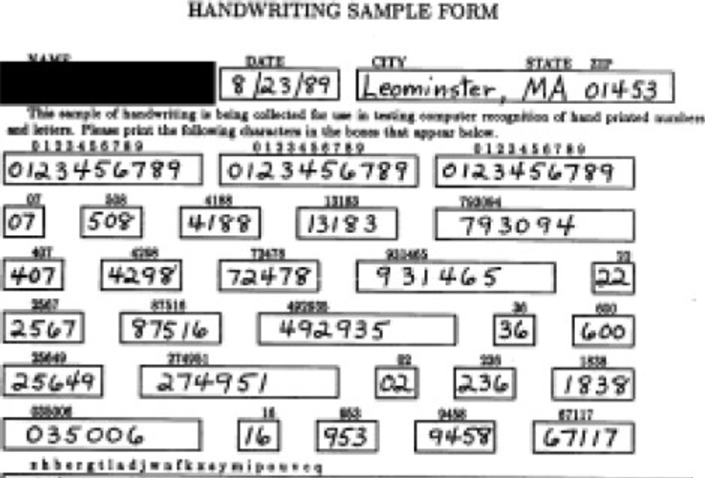
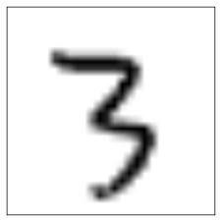
How do we find local features?
How do we find local features?
Let’s revisit the handwritten numbers problem. If we have to find the digit “3” in the form, how would you do it?

Slide 29
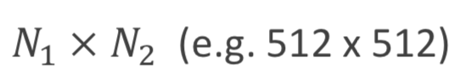





Localization via Correlation
Correlation measures the similarity between two elements. We can find the local feature (in our case 4) by sliding a window over the data and finding the highest correlated output.
Say our image is of the size:
A small filter of the size:
Filter
Image
$$Z[j_{1},j_{2}]$$
High
Low

Slide 30


Terminology used for convolution
In signal processing and mathematics, convolution includes flipping:
Implemented in python using scipy.signal.convolve2d
However, we will call this convolution with reversal (for convenience)
But, in many neural network packages (including Keras), convolution does not include flipping:
In signal processing, this is called correlation.
Implemented in python using scipy.signal.correlate2d
In Deep learning, we will call this convolution.

Slide 31



Boundary Conditions
Suppose inputs are:
The following are different ways to define outputs:
Valid mode:
Requires no zero padding
Same mode: Output size
Usually use zero padding for neural networks
Full mode: Output size
Not used often in neural networks

Slide 32






Boundary Conditions Illustrated
As we discussed above, here are three ways to handle boundary conditions
See excellent github with animated gifs
Valid mode (no zero padding)
Output shape:
Same mode (half zero padding)
Output shape:
Full mode (full zero padding)
Output shape:

Slide 33


2D Convolution Example with Valid Mode

Slide 34

Convolution in Python
Our demo illustrates 2D convolution in Python.
We use the following packages:
skimage: For image processing
scipy signal: For signal processing
We use the “cameraman” image, which is a built-in image (skimage.data).
We perform two convolutions:
Local averaging / blurring
Edge detection

Slide 35


Convolution for Local Averaging
First, consider convolving with a uniform kernel
Each output is a local average of the input
Visually, this blurs the image
Amount of blurring increases with kernel size

Slide 36


Illustration of Boundary Conditions
Notice the black pixels at the boundaries when we use same or full mode, these arise from zero padding
36￼

Slide 37


Averaging vs. Gaussian Filtering
We illustrated the output using a uniform kernel
Now we try a Gaussian kernel.
We can see that both kernels blur the images, but differently.
9x9 Gaussian blur kernel
6/5/19
37￼

Slide 38


Convolution for Edge Detection
Called gradient filters since:
6/5/19

Slide 39


Edge Detection using Sobel Filter

Slide 40

Classic CNN Structure
Starts with convolutional layers.
Each layer does:
2D convolution with several kernels
Activation (e.g., ReLU)
Sub-sampling or pooling
Finish with fully connected (or dense) layers.
Each layer does:
Matrix multiplication
Activation
Convolutional layers
2D convolution with Activation and pooling / sub-sampling
Fully connected layers
Matrix multiplication & activation
40￼

Slide 41

Tensors
Input and output of each layer is a tensor
A multidimensional array
Examples of tensors
Grayscale image: (Height, Width)
Color image: (Height, Width, Chan)
Chan: {Red, Blue, Green}
Batch of images: (Sample, Height, Width, Chan)
Example: A batch of 100 color images with pixels has shape:
The number of dimensions is called the order or rank
Note that rank has a different meaning in linear algebra. Hence, we will use ‘order’ for convenience.

Slide 42



What Do Convolutional Layers Do?
Each convolutional layer has:
Weight tensor: W size
Bias vector: b size
Takes input tensor U creates output tensor
Convolutions performed over space and added over channels
For each output channel m, input channel n
Computes 2D convolution with W[:,:,n,m] (2D filters of size K1 X K2)
Sums results over n
Different 2D filter for each input channel and output channel pair

Slide 43
Subsampling and Pooling
After convolution and activation, there is often a data-reduction stage
There are many options here. Some popular ones are:
Subsampling:
keep the top-left pixel from every S X S region, which is called the stride
Implemented as part of convolution (has no wasted computations!)
Also referred to as “downsampling” in signal processing
Max pooling:
Keep the largest value in each K X K region
Then shift the region by stride S horizontally & vertically
Average pooling:
Keep the largest value in each K X K region
Shift the region by stride S horizontally & vertically
Called ”decimation” in signal processing
The above is performed independently on every channel and batch item

Slide 44

Max Pooling Illustrated

Slide 45



What Dense Layers Do?
Say that the last convolutional layer produced (after pooling) a tensor of shape
Just before the first dense layer, we flatten (i.e., reshape) into matrix U
Shape is
Then output is performed with matrix multiplication:
Same as the linear stages of the 2-layer neural network from the last unit!

Slide 46


Convolution vs Fully Connected
Using convolution layers greatly reduces number of parameters
Ex: Suppose input is
Ex: AlexNet 2nd layer
Convolutional network with
But, a fully-connected layer with same size inputs and outputs:
Convolutional layers exploit translation invariance
Local features are small and could be located

Slide 47

Creating Convolutional Layers in Keras
Done easily with Conv2d
Specify input_shape (if first layer), kernel size and number of output channels
To illustrate:
We create a network with a single convolutional layer
Set the weights and biases (normally these would be learned)
Run input through the layer (using the predict command)
Look at the output

Slide 48



Example 1: Gradients of a BW image
Create simple convolutional layer
Input: BW image, input channel
Two output channels: x- and y-gradient,
*
$$G_{x}=\left[\begin{matrix}1 & 0 & −1 \\ 2 & 0 & −2 \\ 1 & 0 & −1\end{matrix}\right], G_{x}=\left[\begin{matrix}1 & 2 & 1 \\ 0 & 0 & 0 \\ −1 & −2 & −1\end{matrix}\right]$$
Filters
Two gradient
Input.
One channel
Shape = (512,512,1)
48￼

Slide 49


Create a Layer in Keras
Create a single layer model
Use the Conv2D layer
Specify
Kernel size
Number of output channels
Input shape
Why do we have 20 parameters?

Slide 50



Set the Weights
Read the weights and the shapes
Set the weights to the two filters
Normally, these would be trained
Run the input through the network

Slide 51

Perform Convolution in Keras
Create input x
Need to reshape
Use predict command to compute output
Generates two output channels y
Input x
y[:,:,0]
y[:,:,1]
*
Filters
Two gradients

Slide 52


Example 2: Color Input
Input: Single color input
input channels
Input size per sample = 368 x 487 x 3
Output: Filter with four different color filters
Each kernel is 9 x 9
output channels
*

Slide 53


Deep Networks: Using our Tools
What we have at our disposal: Loosely Defined “Layers”
Fully Connected Layers
Linear Transform with activation, $f(Wx + b )$
Convolutional Layers
Conv. Kernels
Pooling
Dimensionality Expansion and Reduction
Important way to intuit the function of layers
Expansion: can gain new insights into data
Reduction: can aggregate and combine information
Conv2D.xlsx short demo
AlexNet Architecture
z
y
x
y
x
Use of Dimensionality Expansion

Slide 54


Slide 55


Slide 56


Slide 57


Slide 58


Application Specific Models
State of the Art, revisited

Slide 59
Thank You!

